Slide 1
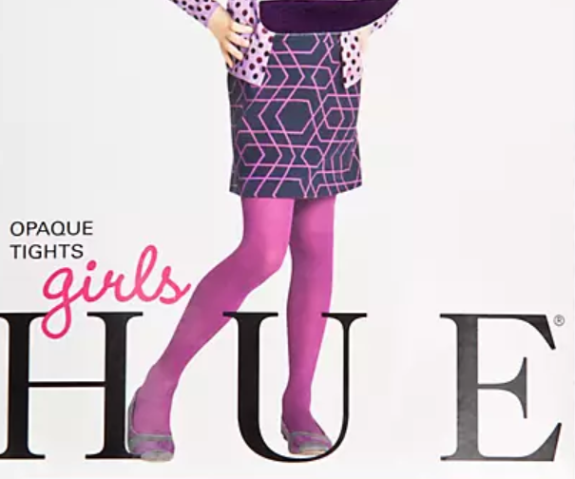
GIRLS TIGHTS OPPORTUNITIES
 | Size
Article Description | XS | S | M | L | XL | Grand Total
FLAT KNIT FOOTLESS TIGHT Total |  | 214 |  | 96 |  | 310
GIRLS FAIRISLE SWEATER TIGHTS Total |  | 107 | 99 | 74 |  | 280
GIRLS' OPAQUE TIGHT Total |  | 11,017 | 6,473 | 852 |  | 18,342
OPAQUE TIGHT Total |  | 23 |  | 24 |  | 47
GIRLS'FOOTLESS TIGHT Total |  | 286 |  | 544 |  | 830
GIRLS'OPAQUE FOOTLSS TGHT Total |  | 57 | 97 |  |  | 154
GIRLS'RINGLET CABLE TIGHT Total |  | 41 |  |  |  | 41
Tights Total | 0 | 11,745 | 6,669 | 1,590 | 0 | 20,004
 | 0% | 59% | 33% | 8% | 0%
GIRLS ORIGINAL DENIM LEGG Total | 356 | 72 | 24 |  |  | 452
HOLD-IT COTTON LEGGINGS Total |  | 26 | 12 | 11 |  | 49
REVERSIBLE DENIM HIGH RISE LEG Total |  | 63 | 483 | 312 | 54 | 912
SLEEK EFFECTS HIGH RISE L Total |  |  |  |  | 71 | 71
SLEEK EFFECTS LEATHERETTE Total |  | 21 |  | 61 |  | 82
SWEATSHIRT DENIM LEGGINGS Total |  |  | 100 |  |  | 100
ULTRA SOFT DENIM LEGGINGS Total |  | 69 | 221 | 54 |  | 344
VELVET LEGGINGS Total |  |  |  | 45 |  | 45
LeggingsTotal | 356 | 251 | 840 | 483 | 125 | 2,055
 | 17% | 12% | 41% | 24% | 6%
Grand Total | 356 | 11,996 | 7,509 | 2,073 | 125 | 22,059
 | 2% | 54% | 34% | 9% | 1%

Slide 2

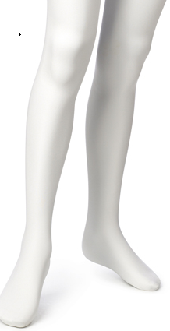
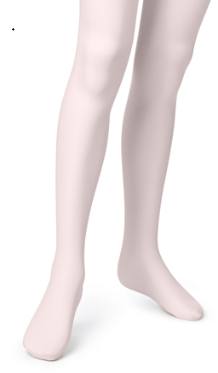
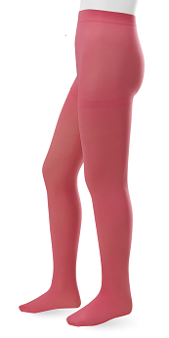
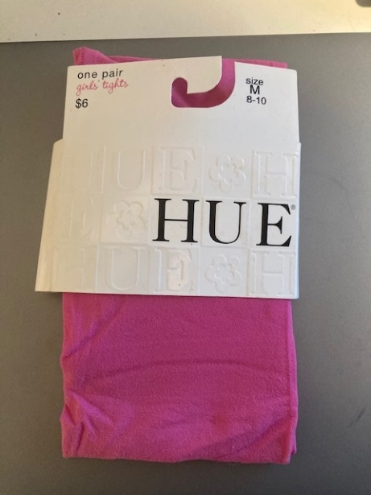
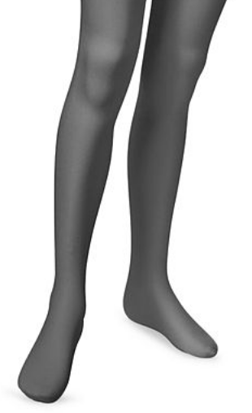
UG11314- GIRLS OPAQUE TIGHT
(single pair)
Ocean Rose
Black
White
Pale Pink
Article Description | Style | Color | S | M | L | Grand Total
GIRLS' OPAQUE TIGHT | UG11314 | BLACK | 3,954 | 2,296 | 420 | 6,670
GIRLS' OPAQUE TIGHT | UG11314 | OCEAN ROSE | 238 | 266 |  | 504
GIRLS' OPAQUE TIGHT | UG11314 | PALE PINK | 2,234 | 2,506 |  | 4,740
GIRLS' OPAQUE TIGHT | UG11314 | WHITE | 2,236 |  |  | 2,236
GIRLS' OPAQUE TIGHT | UG11314M3 | BLACK | 1,039 | 1,049 |  | 2,088
GIRLS' OPAQUE TIGHT | UG11314M3 | WHITE | 102 |  |  | 102
OPAQUE TIGHT | UG11314W | BLACK | 23 |  | 24 | 47
 |  |  | 9,826 | 6,117 | 444 | 16,387
MSRP $6.00

Slide 3
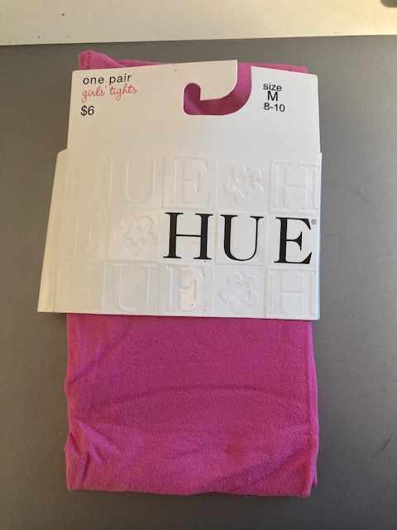
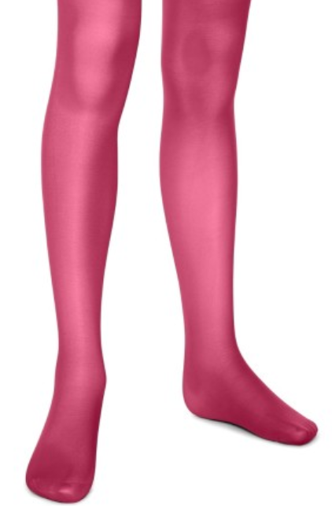
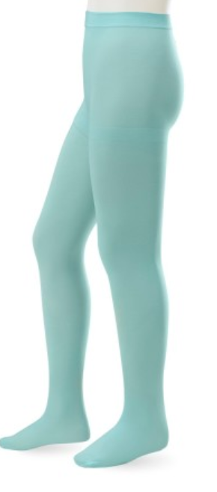
UG11314- GIRLS OPAQUE TIGHT
(single pair)
Raspberry Sorbet
Sea Breeze
Article Description | Style | Color | S | M | L | Grand Total
GIRLS' OPAQUE TIGHT | UG11314 | LIME JUICE | 508 |  | 432 | 940
GIRLS' OPAQUE TIGHT | UG11314 | RASP SORBT | 424 | 182 |  | 606
GIRLS' OPAQUE TIGHT | UG11314 | TEAL |  | 174 |  | 174
GIRLS' OPAQUE TIGHT | UG11314 | THUNDER | 282 |  |  | 282
 |  |  | 1,214 | 356 | 432 | 2,002
MSRP $6.00

Slide 4
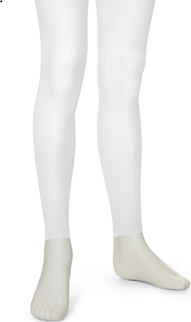
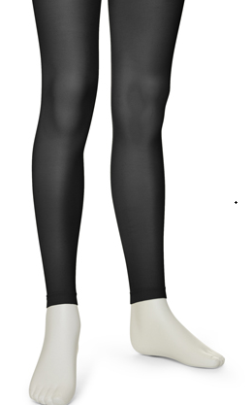
UG13094- GIRLS'FOOTLESS TIGHT
Article Description | Style | Color | S/M | L/XL | Grand Total
FLAT KNIT FOOTLESS TIGHT | UG13094W | BLACK | 118 |  | 118
FLAT KNIT FOOTLESS TIGHT | UG13094W | WHITE | 96 | 96 | 192
GIRLS'FOOTLESS TIGHT | UG13094 | BLACK |  | 296 | 296
GIRLS'FOOTLESS TIGHT | UG13094 | WHITE | 286 | 248 | 534
 |  |  | 500 | 640 | 1,140
MSRP $6.00

Slide 5


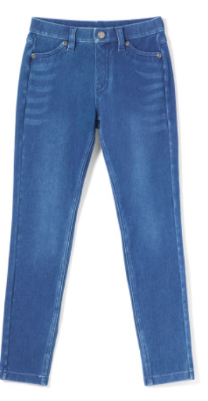
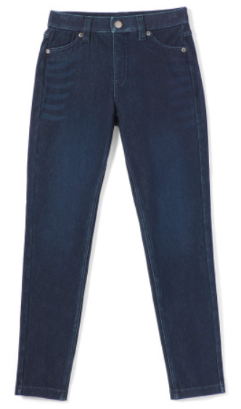
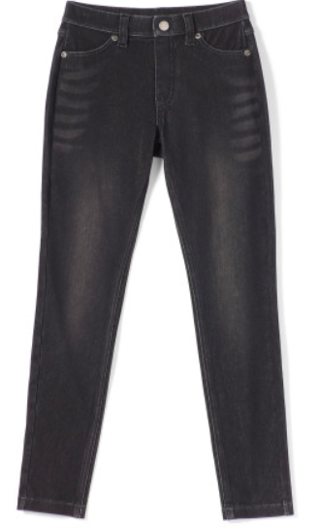
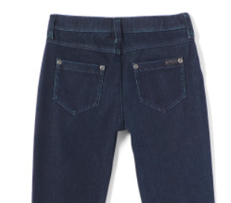
UG23347- ULTRA SOFT DENIM LEGGINGS
Article Description | Style | Color | S | M | L | Grand Total
ULTRA SOFT DENIM LEGGINGS | UG23347 | BLACK INDIGO WASH | 17 | 28 |  | 45
ULTRA SOFT DENIM LEGGINGS | UG23347 | BLACK WASH | 29 | 137 | 38 | 204
ULTRA SOFT DENIM LEGGINGS | UG23347 | MEDIUM WSH | 23 | 56 | 16 | 95
 |  |  | 69 | 221 | 54 | 344
MSRP $38.00

Slide 6
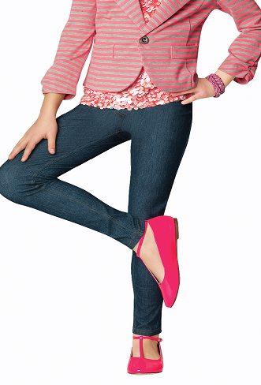
UG13480- GIRLS ORIGINAL DENIM LEGGINGS
Article Description | Style | Color | XS | S | M | Grand Total
GIRLS ORIGINAL DENIM LEGG | UG13480 | MDNGHT RNSE | 338 | 72 |  | 410
GIRLS ORIGINAL DENIM LEGG | UG13480 | MEDIUM WSH | 18 |  |  | 18
GIRLS ORIGINAL DENIM LEGG | UG13480 | WHITE |  |  | 24 | 24
 |  |  | 356 | 72 | 24 | 452
MSRP $24.00

Slide 7
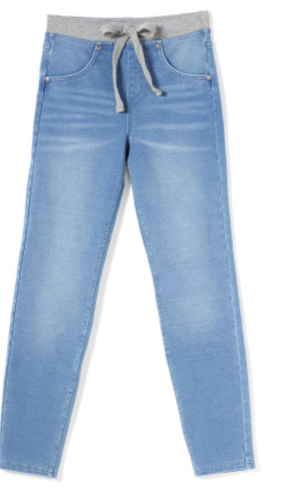
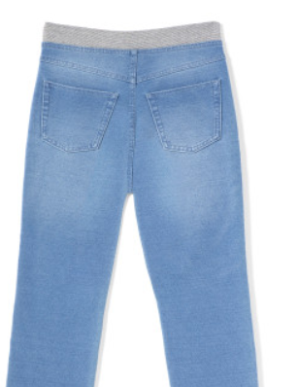
UG23348- SWEATSHIRT DENIM LEGGINGS
Article Description | Style | Color | S | M | L | XL | Grand Total
SWEATSHIRT DENIM LEGGINGS | UG23348 | MEDIUM WSH |  | 100 |  |  | 100
MSRP $28.00

Slide 8
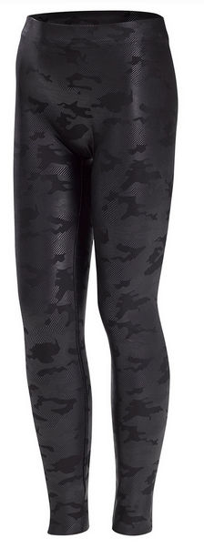
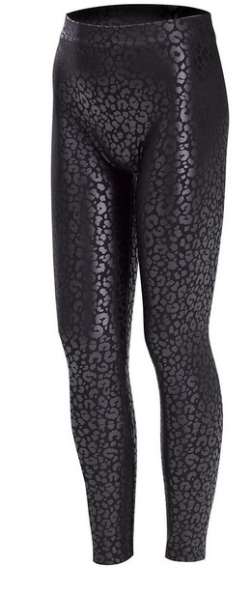
UG22720- SLEEK EFFECTS HI RISE LEGGINGS
Article Description | Style | Color | XL
SLEEK EFFECTS HIGH RISE L | UG22720 | BLACK CAMO | 16
SLEEK EFFECTS HIGH RISE L | UG22720 | BLACK LEOPARD | 55
 |  |  | 71
MSRP $38.00

Slide 9
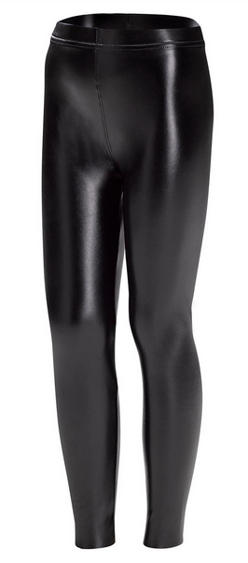
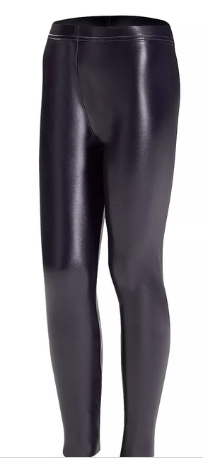
UG22719- SLEEK EFFECTS LEATHERETTE HI RISE LEGGINGS
Article Description | Style | Color | XS | S | M | L | XL | Grand Total
SLEEK EFFECTS LEATHERETTE | UG22719 | BLACK |  | 21 |  |  |  | 21
SLEEK EFFECTS LEATHERETTE | UG22719 | NAVY |  |  |  | 61 |  | 61
 |  |  | 0 | 21 | 0 | 61 | 0 | 82
MSRP $38.00

Slide 10
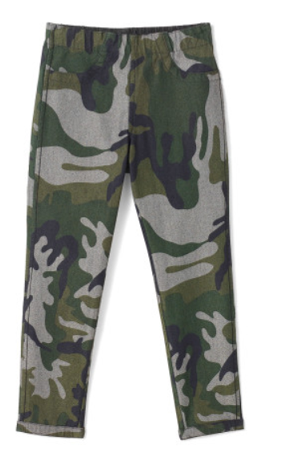
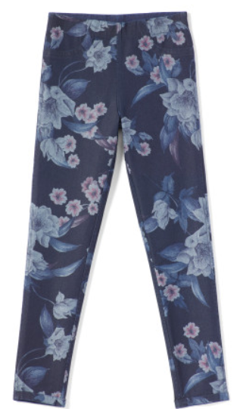
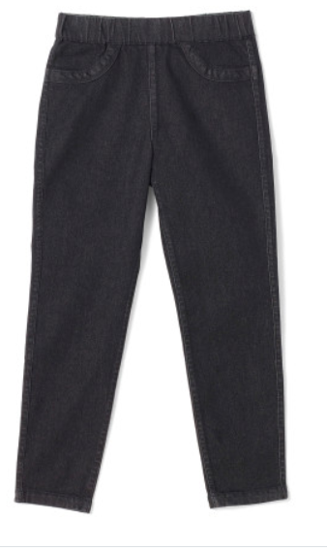
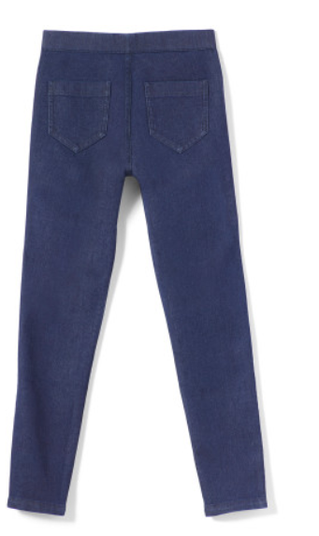
UG23351- REVERSIBLE DENIM HI RISE LEGGINGS
Article Description | Style | Color | S | M | L | XL | Grand Total
REVERSIBLE DENIM HIGH RISE LEG | UG23351 | CAMO |  | 248 | 66 | 40 | 354
REVERSIBLE DENIM HIGH RISE LEG | UG23351 | FLORAL | 63 | 235 | 246 | 14 | 558
 |  |  | 63 | 483 | 312 | 54 | 912
MSRP $68.00

Slide 11
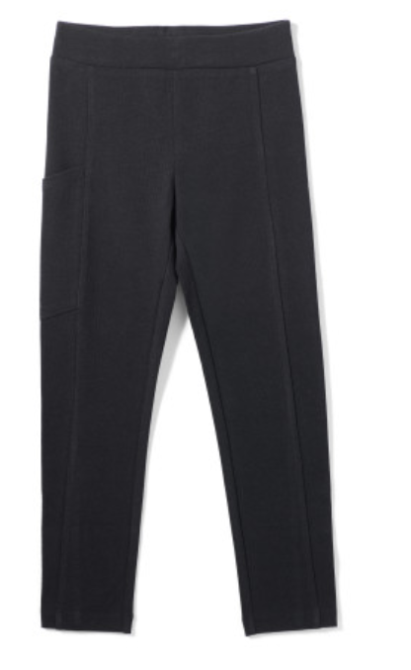
UG23355- HOLD-IT COTTON LEGGINGS
Article Description | Style | Color | S | M | L | Grand Total
HOLD-IT COTTON LEGGINGS | UG23355 | BLACK | 26 | 12 | 11 | 49
MSRP $20.00

Slide 12
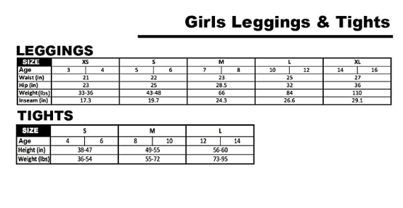
HUE Girls Sizing – 4-16

